Slide 1
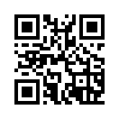
Webex Calling FedRAMP Bootcamp
Herndon, VA
Please join this space using the link below, all presentations and on-going conversations will be taking place there, you can also join via the QR code as well:
https://eurl.io/#tNvgHoJhT
Agenda
Michael Pennington
November 7- 8 2023

Slide 2
Agenda
Day 1 Nov 7
Partner Tools
Webex Control Hub
Labs & Trials
MSFT Integration
Cisco Devices
Day 2 Nov 8
LGW PSTN Lab
Demo Toolbox
Q&A
Call to Action
2 day Partner SE Enablement Event
Focused on Webex Calling FedRAMP
8:30 AM – 5:30 PM ET (3 PM day 2)
2nd day – Primarily Local Gateway PSTN Lab
Partners will:
  Know where to go for Webex Calling FedRAMP resources
  Get hands-on training with Cisco’s Webex Control Hub
  Understand features and functionalities of Webex Calling FedRAMP
  Understand Microsoft integrations w/Webex Calling FedRAMP
  PSTN Local Gateway Technical Deep dive
  Leave with fully functioning Control Hub sandbox
https://eurl.io/#tNvgHoJhT

Slide 3
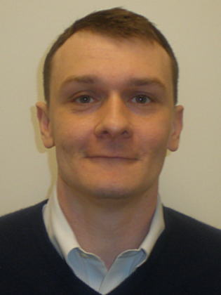
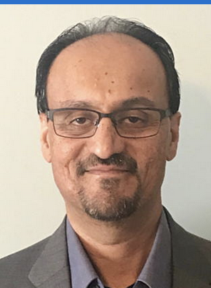
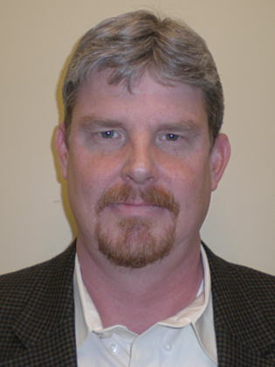
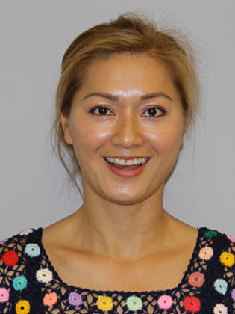
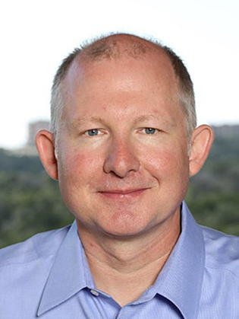
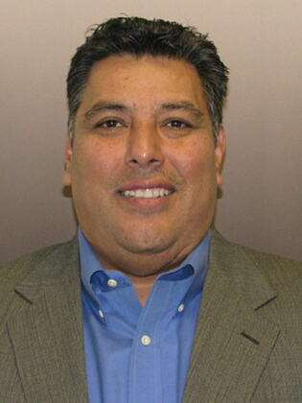
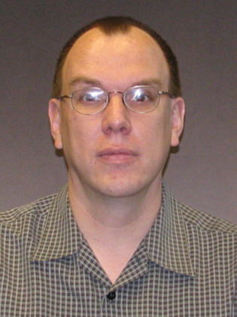
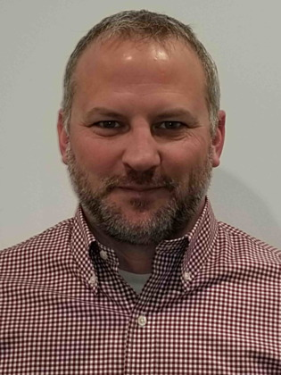
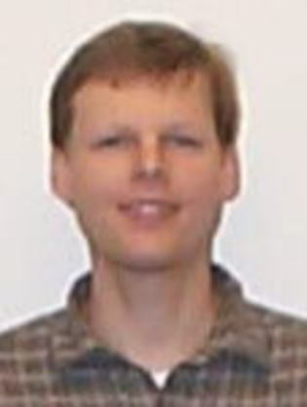

Cisco Staff
Please join space:
https://eurl.io/#tNvgHoJhT
Keith Hughes
VAR Channels PBDS
Bhupinder Bakshi
SP Channels TSA
Dolan Spitler
VAR Channels TSA
Toni Kha
Product Management Leader
Michael Pennington
VAR Channels GTM
Tony Reyes
SP Channels TSA
Ed Schermerhorn
Technical Marketing Engineering
Bryan Freed
Sr. Manager, Webex Public Sector
David Scott
Engineering Product Manager

Slide 4
Nov 7th Agenda - Morning
Please join space:
https://eurl.io/#tNvgHoJhT
Time - ET | Topic | Presenter
8:00 AM – 8:30 AM | Arrivals
8:30 AM – 9:00 AM | Welcome and Offer Review | Michael Pennington/Keith Hughes/Bryan Freed
9:00 AM - 9:15 AM | Resources and Tools | Tony Reyes
9:15 AM - 10:15 AM | Getting started with Control Hub Sandbox Lab | Tony Reyes
10:15 AM – 10:45 AM | Break
10:45 AM – 11:45 AM | Redsky E911 WxC Lab | Tony Reyes
11:45 AM – Noon | Creating New Trials from Partner Control Hub | Bryan Freed
Noon – 1:00 PM | Lunch (Italian)

Slide 5
Nov 7th Agenda - Afternoon
Please join space:
https://eurl.io/#tNvgHoJhT
Time - ET | Topic | Presenter
1:00 PM – 2:00 PM | Demo Toolbox – Live Demo | Bhupinder Bakshi
2:00 pm - 3:00 PM | Working With Microsoft Teams | Bhupinder Bakshi
3:00 PM – 3:15 PM | Break
3:15 PM – 4:15 PM | Contact Center Lite Solutions and GCM Features plus Lab | Dolan Spitler
4:15 PM – 5:45 PM | Phones and Video Endpoints | Toni Kha/David Scott
6:30 PM After- Hours | Herndon Offsite – bartaco

Slide 6
Nov 8th Agenda
Please join space:
https://eurl.io/#tNvgHoJhT
Time - ET | Topic | Presenter
8:00 AM – 8:30 AM | Arrivals
8:30 AM – 10:30 AM | Local Gateway PSTN Lab | Ed Schermerhorn
10:30 AM - 10:45 AM | Break
10:45 AM – 12:45 PM | Local Gateway PSTN Lab (cont.) | Ed Schermerhorn
12:45 PM – 1:30 PM | Lunch (Mediterranean Food Truck)
1:30 PM – 2:15 PM | Understanding and Positioning Webex Calling With Webex Edge | Bhupinder Bakshi
2:15 PM – 3:00 PM | Q&A/Wrap Up/Call To Action | Michael Pennington

